Slide 1

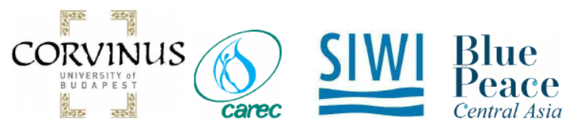
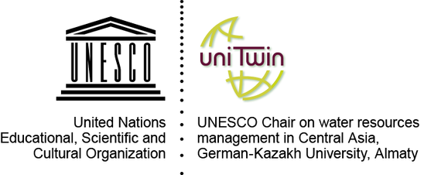

Outlining the economic foundations of regional cooperation on water in Central Asia
Thursday, 15 April 2021
the 3rd webinar
An introductory statement on IWRM for the Amudarya, Syrdarya and the Aral Sea Basin
Barbara Janusz-Pawletta
Vice-rector for International Cooperation
UNESCO Chair Holder in Water Management in Central Asia
Kazakh-German University, Almaty
E-mail: janusz-pawletta@dku.kz

Slide 2



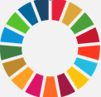
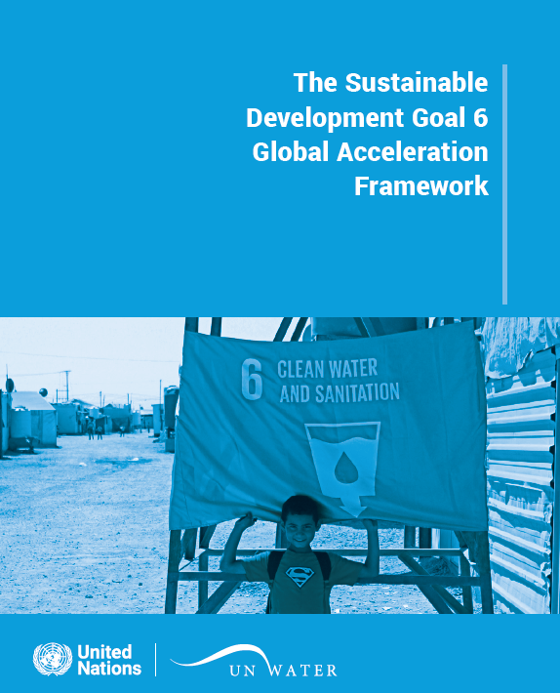
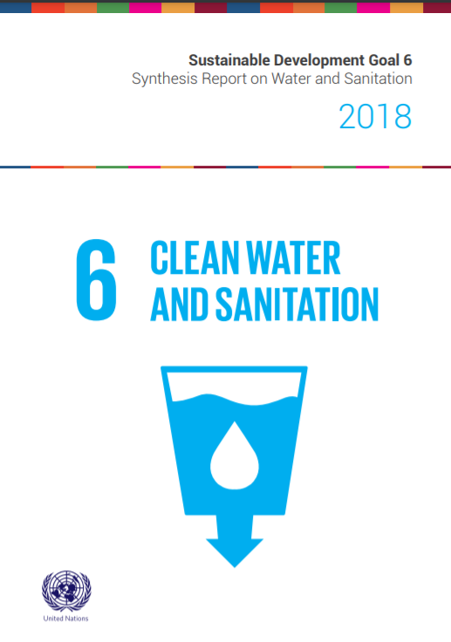

IWRM as a part of global policy agenda
“By 2030, implement integrated water resources management at all levels, including through transboundary cooperation as appropriate”

Slide 4
Definition of IWRM
Integrated Water Resources Management (IWRM) is a process which promotes the coordinated development and management of water, land and related resources in order to maximise economic and social welfare in an equitable manner without compromising the sustainability of vital ecosystems and the environment.
Global Water Partnership (2004)
Water valuation instruments
IWRM & Water economics
Water financing & pricing

Slide 5
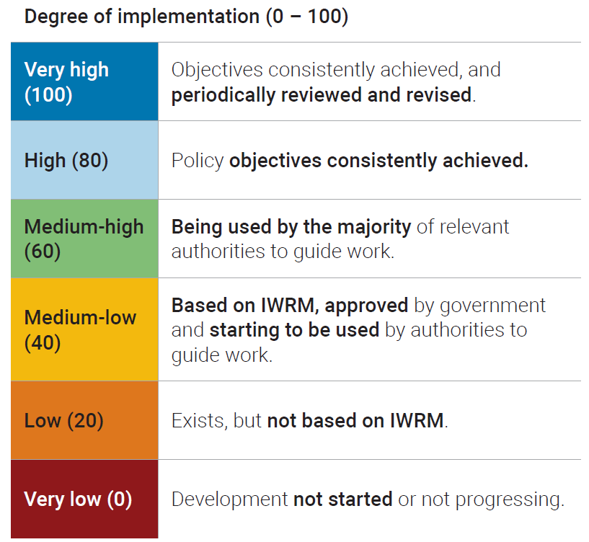
Reporting on SDG 6.5.1
Example of thresholds from question 1.1a on status of water resources policy
Indicator: 6.5.1: Degree of integrated water resources management implementation (0-100)
Country survey covering 4 elements of IWRM:
  Enabling Environment
  Institutions
  Management Instruments
  Sustainable Financing

Slide 6
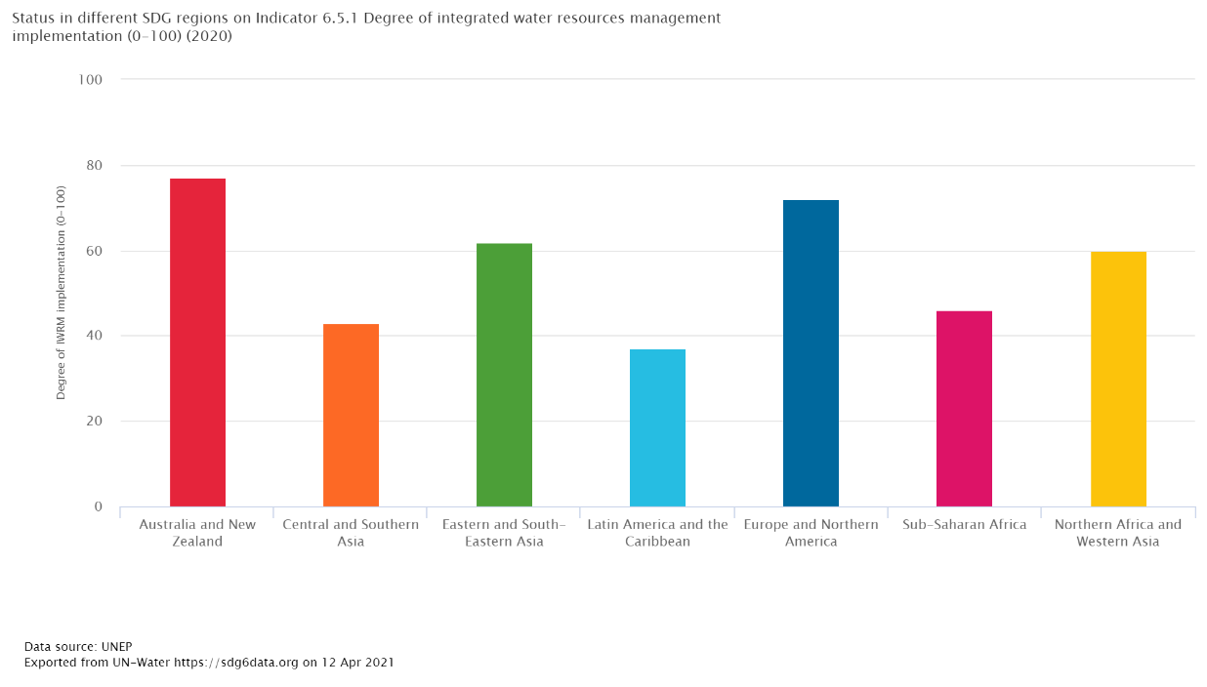
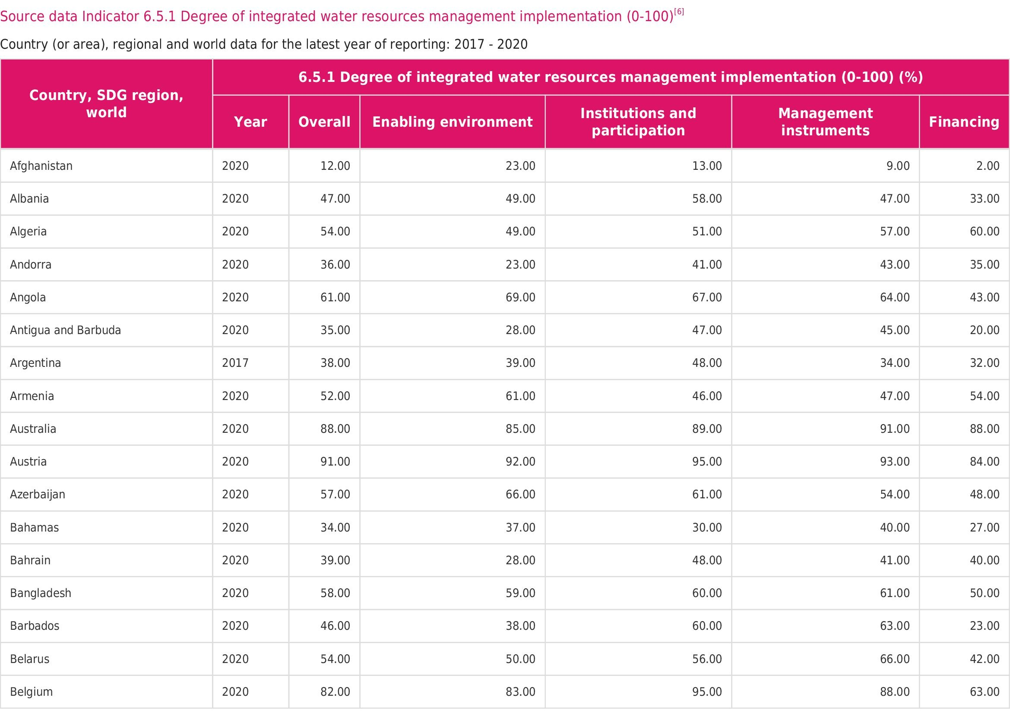
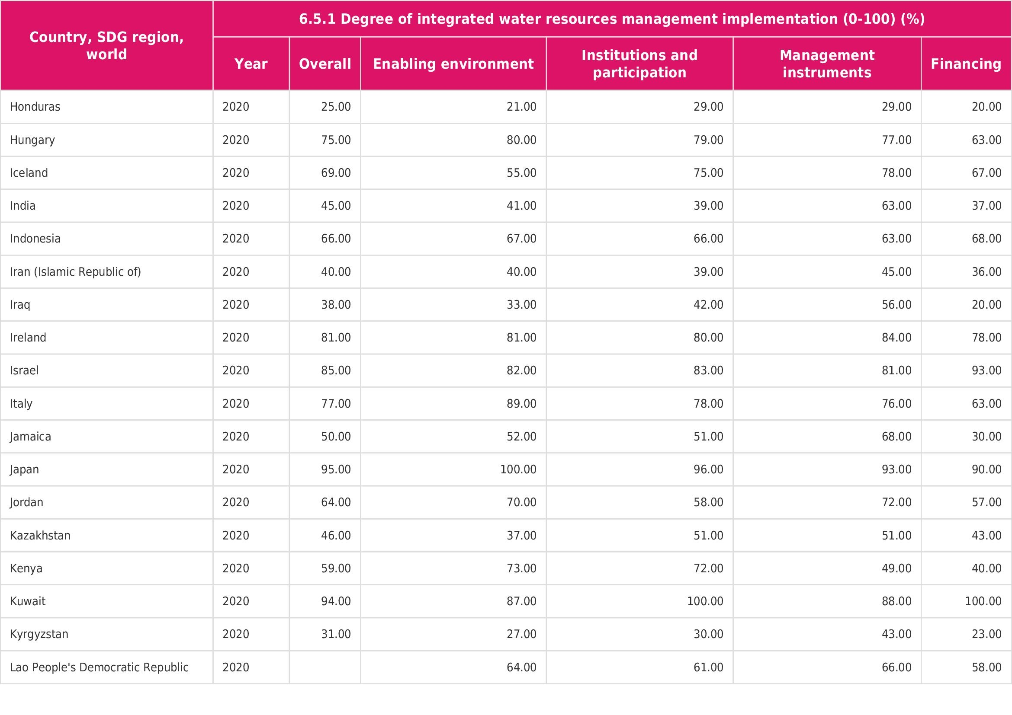
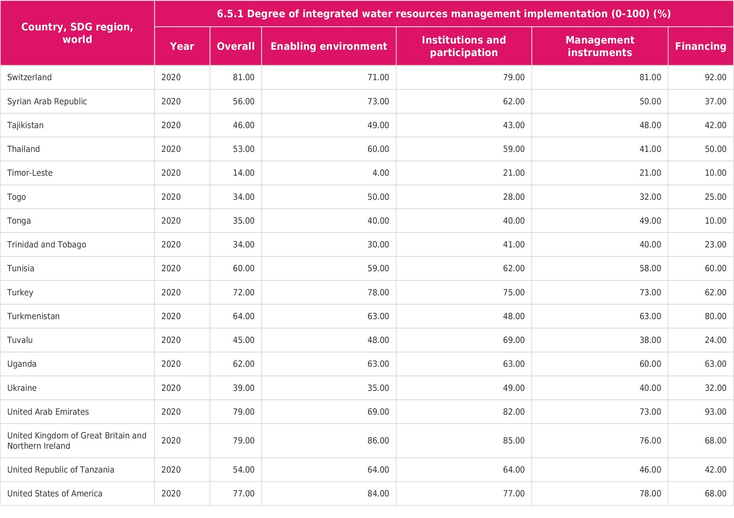
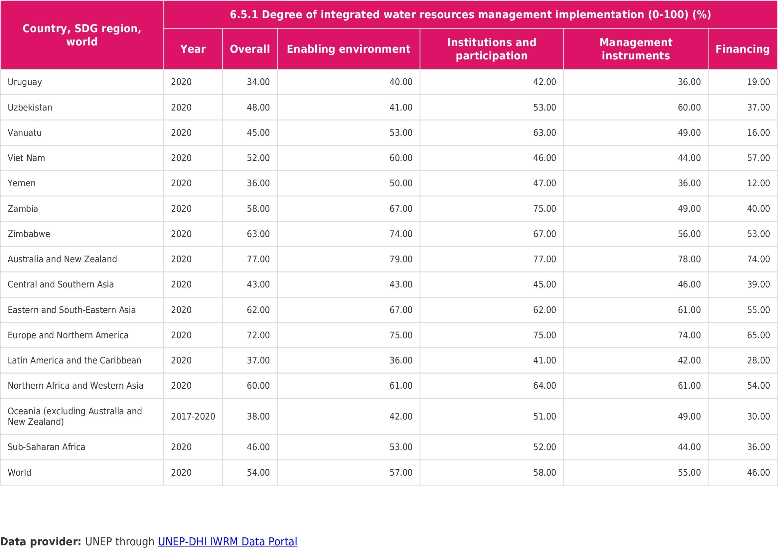
IWRM in Central Asia

Slide 7
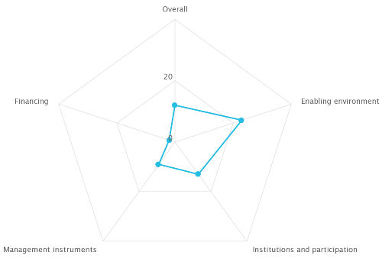
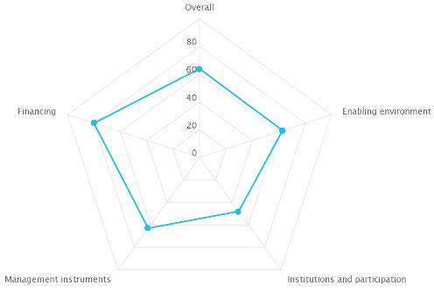
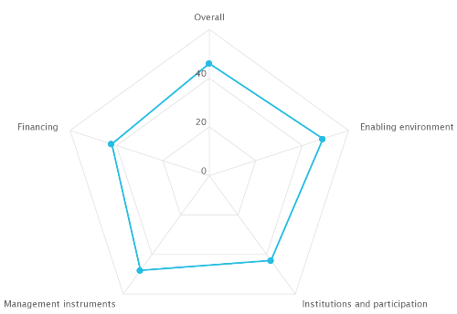
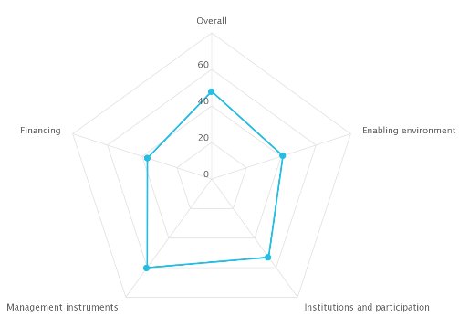
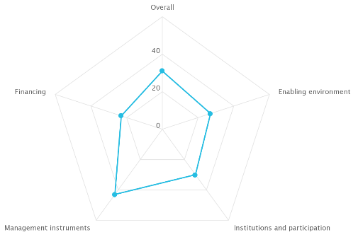
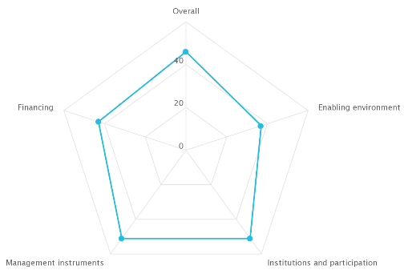
Afghanistan
Uzbekistan
Tajikistan
Kyrgyzstan
Kazakhstan
Turkmenistan
Degree of integrated water resources management implementation 31 %
Degree of integrated water resources management implementation 12 %
Degree of integrated water resources management implementation 46 %
Degree of integrated water resources management implementation 46 %
Degree of integrated water resources management implementation 64 %
Degree of integrated water resources management implementation 48 %

Slide 8
Way forward
Regional integration beyond water influences riparian states readiness to cooperate in water issues
Strengthening interstate integration formats among Central Asia on economic issues beyond water
Enhancing existing legal and institutional frameworks to implement IWRM

Slide 9


THANK YOU FOR YOUR ATTENTION!
Dr. iur. Barbara Janusz-Pawletta
Vice-rector for International Cooperation,
UNESCO Chair Holder in Water Management in Central Asia at DKU
email: janusz-pawletta@dku.kz

